Slide 1
Online Validation Of University E-certificate For Scholarship Grant With Compliance Of Data Security Principles And Biometric Authentications
A project report submitted in partial fulfilment of the requirements of the award of the degree of Bachelor of Technology in Computer Science and Engineering under the supervision of Mr. Soumit Choudhury
by
Koustav Mondal (GCECTB-R19-3015)
Bickram Adhikari (GCECTB-R19-3012)
Sourin Kundu (GCECTB-R19-3032)
Soumil Biswas (GCECTB-R19-3030)

Slide 2
Proposed work at a glance
Online validation of university E-Certificate for scholarship
On-spot validation of Physical Presence of Student with biometric signatures
Online Validation of Scholarship Payment Transaction

Slide 3
POSSIBLE FRAUD CAUSES IN A SCHOLARSHIP PROCESS
Forgery of Candidates’ data by Third Party
Tampering of data by the Genuine Candidate
False Confirmation from the Scholarship Authority
Fraud cases related to the proposed Scholarship Amount
Fraud E-certificate generation from fake university server

Slide 4
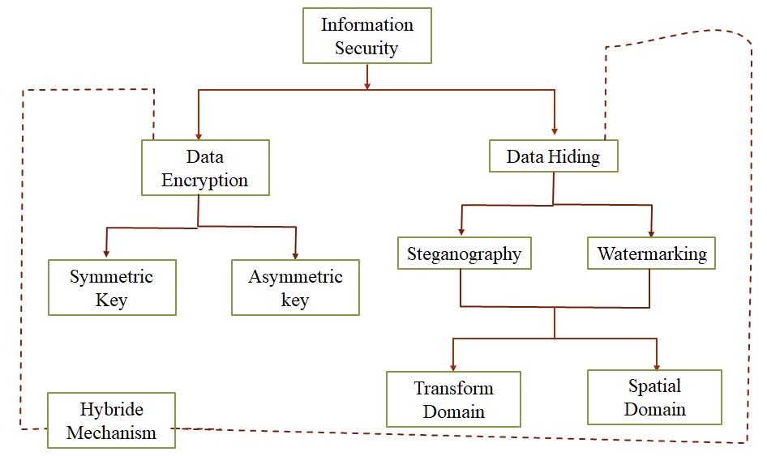
GENERAL CONCEPT OF DATA SECURITY TECHNIQUES
Information Security
Data Encryption
Data Hiding
Steganography
Watermarking
Symmetric Key
Asymmetric Key
Transform Domain
Spatial Domain
Hybrid Mechanism

Slide 5
Specific Data Security tools
Cryptography
Steganography
Watermarking
Confidentiality is achieved by the encoding of transmitted data within a carrier signal. (image)
Robustness of data protection of secret data against external attacks.
Data is encoded.
It is an evolution of cryptography, where data is hidden within the carrier signal in an imperceptible manner such that intruder is unaware about the existence of the hidden data.
Data sent to the receiver in an unrecognizable format.
Further evolution from Steganography.
Here, embedded sensitive data is protected from different external attacks.

Slide 6
Multiple watermarking
Watermarking
Composite
Segmented
Successive
Composite: Formation of a single watermark from all watermarks and placing it in one embedding step.
Segmented : Partitioning of the host image into separate segments and each watermark is fixed into its particular segment.
Successive: The watermarks are placed one on top of another.
We are using Segmented Water-marking to ensure more possibility of attack survival.

Slide 7
Issues addressed in Proposed data security protocol for enhancement on the existing concepts
Existing concepts | Proposed concept
1. Mainly handles authentications and tampering by way of watermarking approaches. | 1. Considers all the major data security issues like authentication, confidentiality, integrity and non-repudiations.
 | Here, more stronger form of authentications are addressed with digital signature(using visual cryptographic concepts) and biometric authentications.
 | Trustable data integrity solutions with self define hash operations on critical sensitive data and based on that signature hiding takes place.
 | More trustable biometric authentications with fingerprint and voice sample embedding on e-certificates.

Slide 8
Issues addressed in Proposed data security protocol for enhancement on the existing concepts(contd.)
Existing concepts | Proposed concept
2. Mainly similar data hiding concepts applied throughout the whole cover image. | 2. Here, two parameters are considered for data hiding i.e., circular orientation of signature fragments and their embedding matrix intervals.
 | Variable signature bit encoding based data hiding concepts with variable threshold range values and, also combination of spatial and transform domain based data hiding algorithms.

Slide 9








Protocol Stage 1(University Verification)
SPP
1
Institution Server
Public Share
Mobile No., College Name
OTP
3
OTP
Hash H1, H2 from OTP, Roll No., and College Name
Report Card
2
Student
OTP
Mobile of Candidate
4
Putting both overlay together
Public Share of institution
Detected private share of institution logo
e-copy of Grade Card
Proper University Logo establishing Institution Verification

Slide 10

Stage 2(Biometric Verification – Phase 1)
SPP
Institution Server
Public Share
5
Year of Passing, DGPA
OTP
OTP
6
Verification Failed
Hash Values H3, H4
Student
OTP
7
Mobile of Candidate
Putting both overlay together
8
Public Share of Fingerprint
Match?
Private Share of Fingerprint
NO
YES
Biometric Verified

Slide 11

Stage 3(Biometric Verification – Phase 2)
SPP
Institution Server
Public Share
9
Year of Passing, DGPA
OTP
OTP
10
Verification Failed
Hash Values H5, H6
Student
OTP
11
Mobile of Candidate
Putting both overlay together
12
Public Share of Voice
Match?
Private Share of Voice
NO
YES
Biometric Verified

Slide 12

Stage 4(Transaction Verification – End of Verification Process)
15
YES
SPP
Received SMS validated?
Left Thumb Impression
Student
Proposed Amt. not Received
NO
Transaction ID,
Transaction Amount
Transaction ID,
Transaction Amount
SMS
14
Mobile of Candidate
13
Private Share of Transaction Notice
Putting both overlay together
Public Share of Transaction Notice
Hash Values H7, H8
16
Match?
NO
YES
Transaction Not Verified
Transaction Verified

Slide 13



Share Generation Algorithm
Share Generation
Original Share
Private Share
Public Share
Share Retrieval
Private Share
Public Share
Original Share

Slide 14
Share Generation Algorithm
For share Generation: Take an image A to be split into two shares E1 and E2
Each pixel position (ps) has an RGB intensity value R[ps], G[ps], B[ps], we derive the RGB value for each pixel in E1 with the function:
E1r= R[ps] mod 8 + (ps) mod 11 + Vr…………………………………………...(1)
E1g= G[ps] mod 16 + (ps) mod 13 + Vg…………………………………………(2)
E1b= B[ps] mod 24 + (ps) mod 15 + Vb…………………………………………(3)
Repeat The process for all pixels in the Image
For Image E2, we use the function:
E2r=R[ps]-E1r…………………………………………………........................(4)
E2g=G[ps]-E1g……………………………………………………………………...(5)
E2b=B[ps]-E1b………………………………………………………………………(6)

Slide 15
Share Generation Algorithm(Contd.)
To get the original image back from E1 and E2, we use the function:
E1r[ps]+E2r[ps]=R[ps]…………………………………………………………(7)
E1g[ps]+E2g[ps]=G[ps]………………………………………………………..(8)
E1b[ps]+E2b[ps]=B[ps]………………………………………………………..(9)
Repeat this for each pixel to retrieve back the original image.
Private Share (E1)
Public Share (E2)
Original Share

Slide 16
Cover Image Region/Segment Wise Signature Verification
E-scholarship is logically divided into 4 regions and each region is further divided into 4 segments having consecutive set of 2x2 pixel byte matrix sub blocks.
Segment 2
Region 1
2x2 pixel byte matrix sub blocks
Segment 3
Segment 4
E-scholarship
Region 3
Region 4

Slide 17
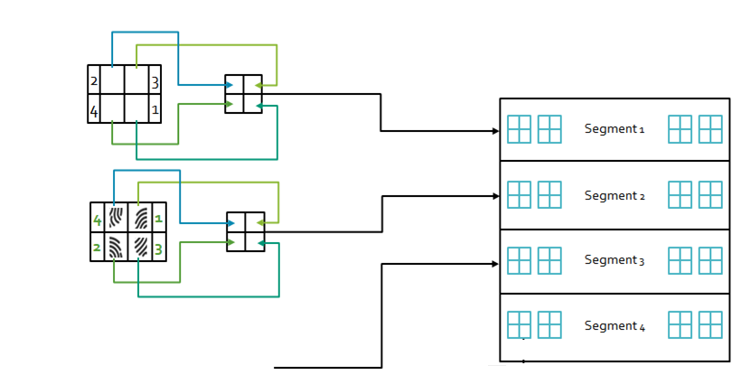





Cover Image Region/Segment Wise Signature Verification(contd.)
Commission private share fabrication in segment 1
Segment 1
Candidate right thumb impression fabrication in segment 2
Segment 2
Segment 3
Candidate voice spectrogram in segment 3
Segment 4
Candidate left thumb impression in segment 4

Slide 18
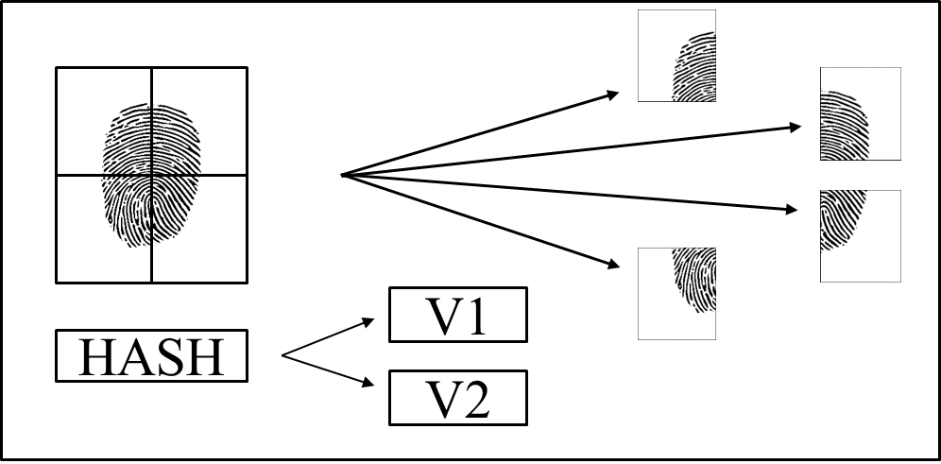
Signature Fragmentation

Slide 19
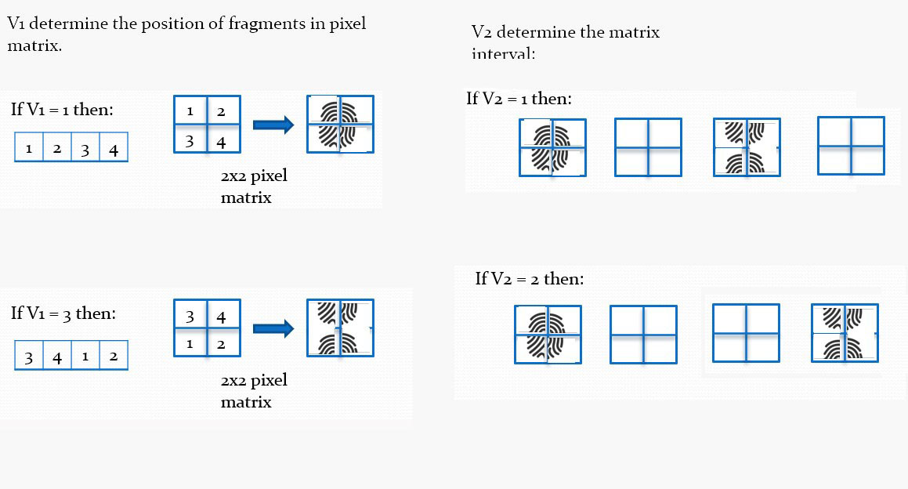
Data Encryption

Slide 20
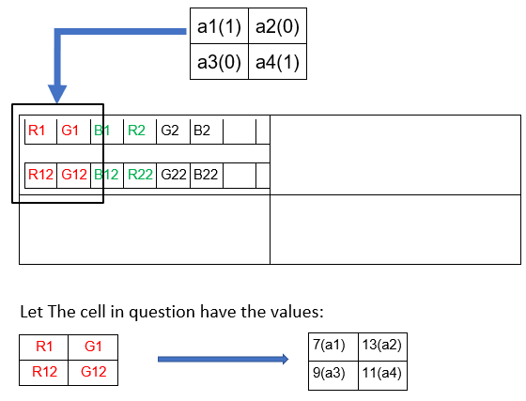
Secret Data Encoding & Decoding Algorithm
Encryption:
Data to be Embedded: 1001.
Take each element of this value in a 2X2 matrix
Such that:

Slide 21
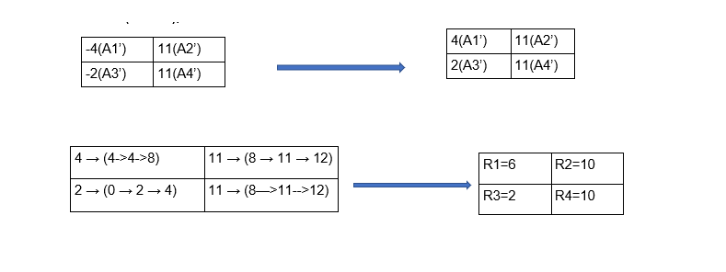
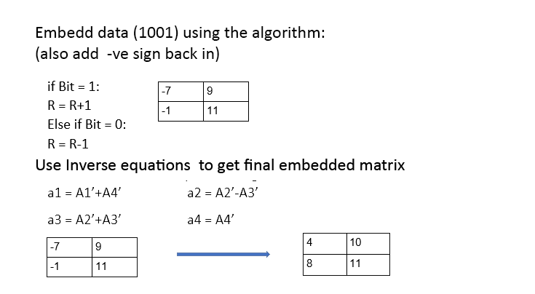
Transform a1, a2, a3, a4 to A1’, A2’, A3’, A4’ (remove –ve signs)
A1’ = a1-a4 A2’ = (a3+a2)/2
A3’ = (a3-a2)/2 A4’ = a4
Calculate and place R1, R2, R3 R4 from A1’, A2’, A3’, A4’
For each cell, consider x & y (multiples of 4) such that x <= A1’ < y for all cells. Transform A1’, A2’, A3’ & A4’ to R1, R2, R3 & R4 using the equation: R= (x + y)/2

Slide 22
Decryption:
Received Image Matrix: Decoding=>
C1 = a1-a4 C2 = (a3+a2)/2
C3 = (a3-a2)/2 C4 = a4
4 | 10
8 | 11
C1 = -7 | C2 = 9
C3 = -1 | C4 = 11
(Omit –ve signs at this stage for absolute measurement)
C1’ = 7 (4 < 7 < 8) | C2’ = 9 (8 < 9 < 12)
C3’ = 1 (0 < 1 < 4) | C4’ = 11 (8 < 11 < 12)
R1 = 6 | R2 = 10
R3 = 2 | R4 = 10
Use the following loop to extract the embedded message
If Ci’ >= Ri:
print 1
else:
print 0
Extracted Data: 1001

Slide 23
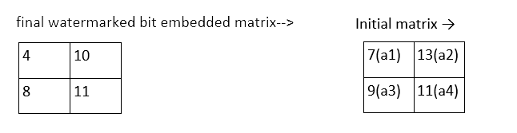
Data Hiding Deviation:
Difference between final and initial values of each cell D(i) in the matrix
D1=3 D2 =3 D3 = 1 D4 = 0
Avg = d1+d2+d3+d4 / 4 = 7/4 = 1.75
Deviation % = 0-255 → 1.75/255 * 100 % = 0.68% deviation
This level of deviation is not identifiable by human vision and can fly under the radar as unsuspicious.

Slide 24
Quantitative experimental data for TDS Algorithm:
Sample 1 | Sample 2 | PSNR | SSIM | MSE | CC
logo | secret-reg-1-seg-1 | 24.9297 | 0.78927 | 208.981 | 0.980873
logo | secret-reg-2-seg-1 | 24.9473 | 0.81138 | 208.135 | 0.981861
logo | secret-reg-3-seg-1 | 24.0767 | 0.77994 | 254.335 | 0.976143
logo | secret-reg-4-seg-1 | 23.7401 | 0.77387 | 274.837 | 0.973726
thumb-56x56 | secret-reg-1-seg-2 | 23.8869 | 0.92716 | 265.700 | 0.989641
thumb-56x56 | secret-reg-2-seg-2 | 24.3109 | 0.93306 | 240.983 | 0.990038
thumb-56x56 | secret-reg-3-seg-2 | 24.4796 | 0.93803 | 231.806 | 0.990946
thumb-56x56 | secret-reg-4-seg-2 | 24.3182 | 0.93246 | 240.581 | 0.989830
(Realistic Values of PSNR are around 20-30 for practical testing)

Slide 25

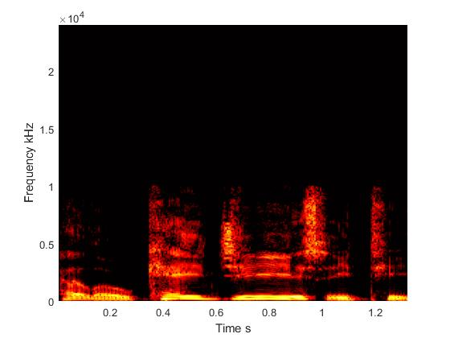
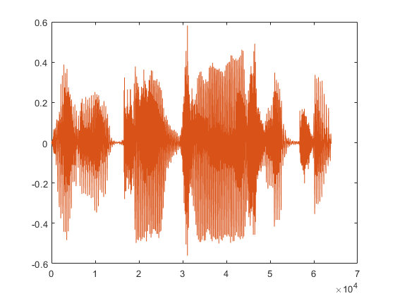
Voice Authentication System
First, we convert the Audio file into a visible graphical format, we are choosing a basic sound plot, spectrogram and a histogram.
Reference audio file
Target audio file

Slide 26
Then we attempt to retrieve four different image comparison values:
PSNR (Peak Signal to Noise Ratio),
SSIM (Structural Similarity index),
MSE (Mean Squared Error) and
CC (2D Correlation Coefficient);
in order to get a clearer and quantitative comparison of the given images.
A = imread('Peter GCECT.tif');
B = imread('Peter KGECT.tif');
[peaksnr, snr] = psnr(B, A);
[ssimval, ssimmap] = ssim(B, A);
err = immse(B, A);
c = corr2(A, B);
If the comparison values are in an acceptable range (factoring in for external noise sources), the target audio is verified, otherwise it is flagged for mismatch and the system may request for a re-take.

Slide 27
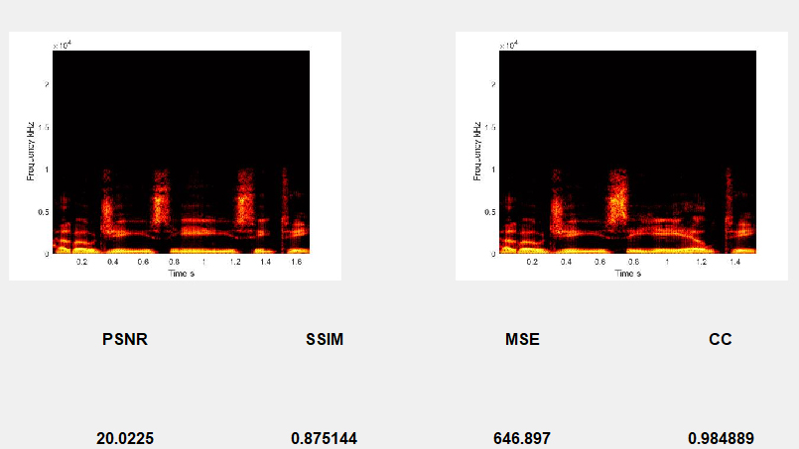
Test Cases - Case 1 (Same Phrase, Different Voice) :

Slide 28
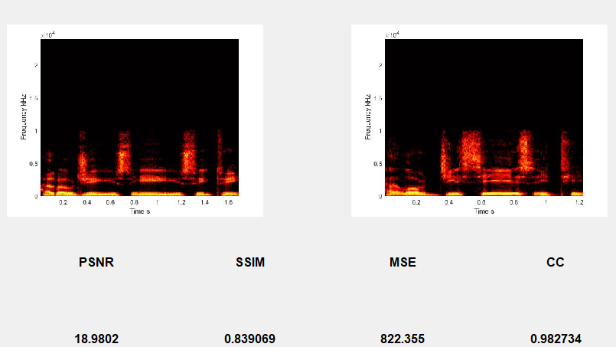
Test Cases - Case 2 (Different Phrase, Same Voice) :

Slide 29
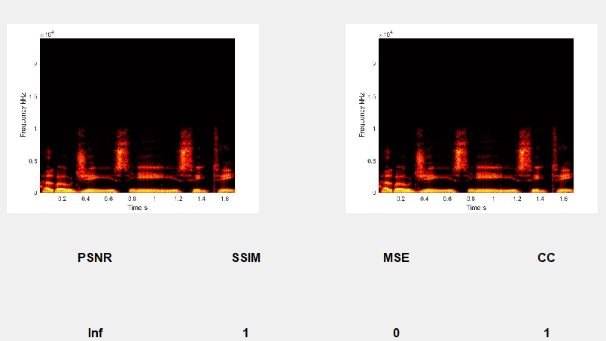
Test Cases - Case 3 (Same Phrase, Same Voice) :
(Realistic Values of PSNR are around 20-30 for practical testing)

Slide 30
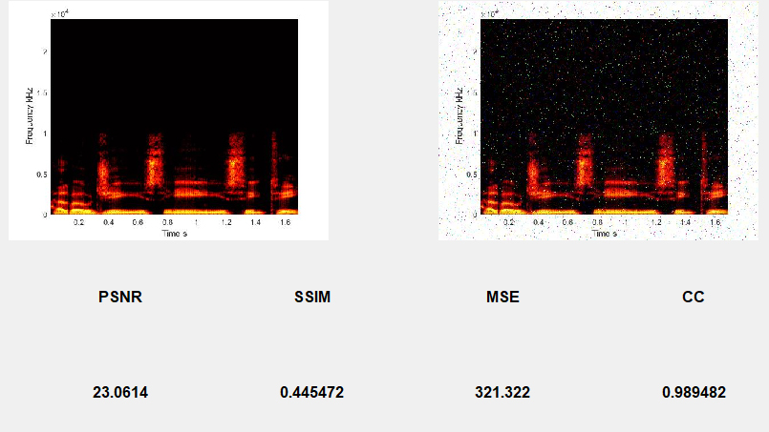
Test Cases - Case 4 (Same Phrase, Same Voice, Added Noise) :
Noise: Salt & Pepper, 0.05 (5%)
(Closer representation of practical testing)

Slide 31
Experimental Values for Different Comparisons:
Sample 1 | Sample 2 | PSNR | SSIM | MSE | CC
Voice1 “GCECT” | Voice2 “GCECT” | 12.1635 | 0.66866 | 3951.2 | 0.590765
Voice1 “GCECT” | Voice2 “GCELT” | 12.6271 | 0.69067 | 923.245 | 0.980802
Voice1 “GCECT” | Voice1 “GCECT” | Inf | 1 | 0 | 1
Voice1 “GCECT” | Voice1 “GCECT” 2% noise | 20.4354 | 0.58444 | 588.225 | 0.962638
Voice1 “GCECT” | Voice1 “GCECT” 5% noise | 16.4483 | 0.42218 | 1473.15 | 0.909408
Voice1 “GCECT” 2% noise | Voice1 “GCECT” 5% noise | 15.0376 | 0.38078 | 2038.55 | 0.875282
Voice1 “GCECT” | Voice1 “KGECT” | 12.906 | 0.70620 | 3330.24 | 0.635514
Voice2 “GCECT” | Voice2 “KGECT” | 12.9844 | 0.69567 | 3270.69 | 0.642318
Voice1 “GCECT” 2% noise | Voice1 “GCECT” 9% noise | 13.0954 | 0.32995 | 3188.14 | 0.813395

Slide 32
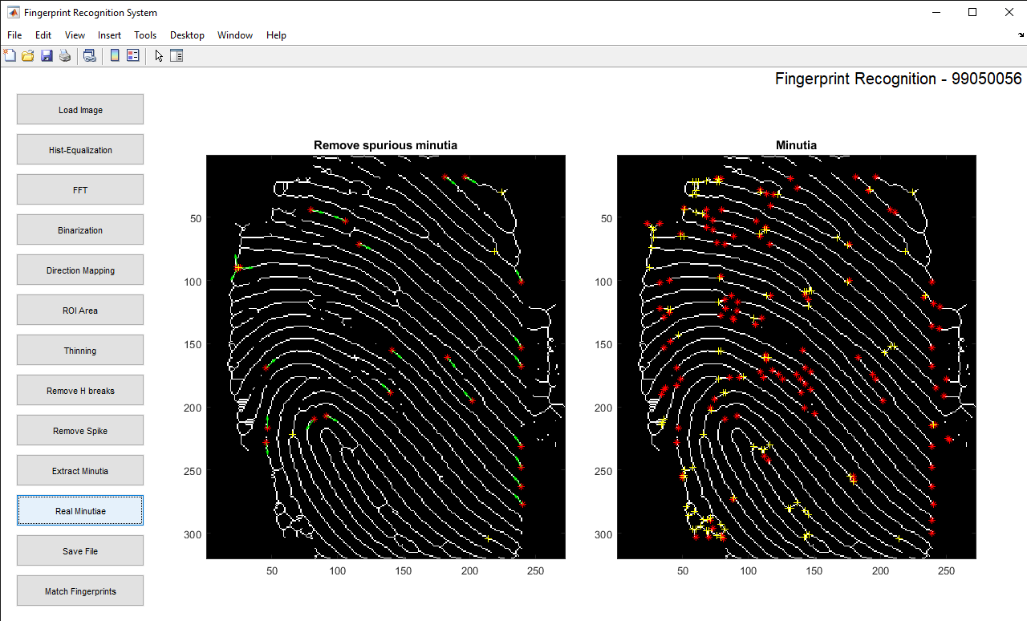

Fingerprint Verification System
The procedure makes use of the tried and tested minutiae-based Fingerprint Identification System, which extracts minutia features (ridges, grooves, bifurcations and terminations) from a fingerprint and compares them to the sample database to identify the person to whom the fingerprint belongs.
Extract
Save
Fingerprint
Minutiae
.dat File

Slide 33
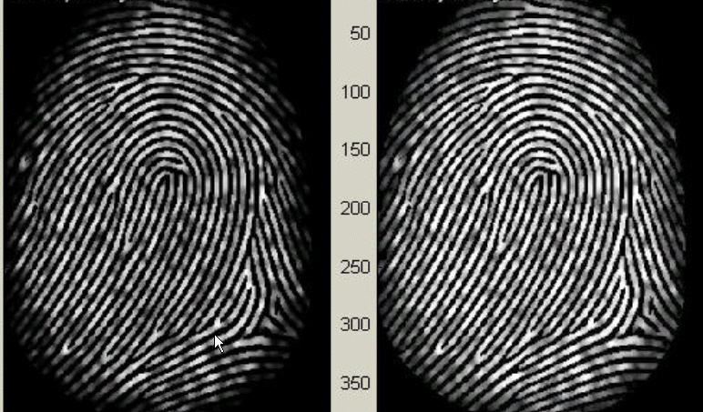
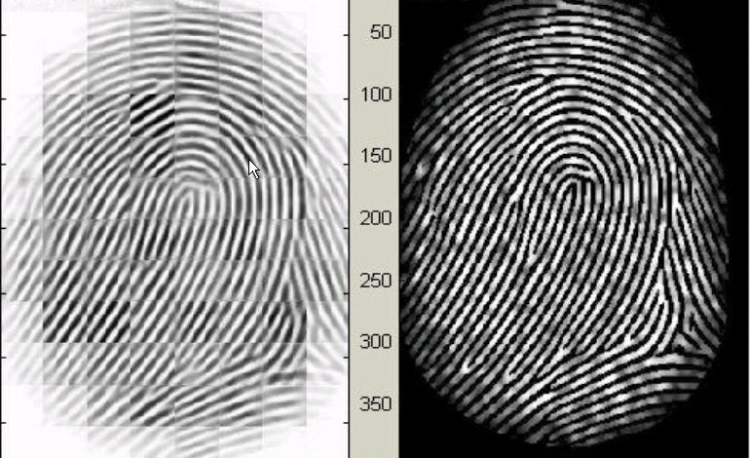

Step 1 – Histogram Equalization:
First, we enhance the target fingerprint using Histogram-equalization. Histogram equalization is to expand the pixel value distribution of an image so as to increase the perceptional information.
Histogram Enhancement. Original Image (Left). Enhanced image (Right)
The k in formula (2) is an experimentally determined constant, which we choose k=0.45 to calculate.
Fingerprint enhancement by FFT Enhanced image (left), Original image (right)

Slide 34
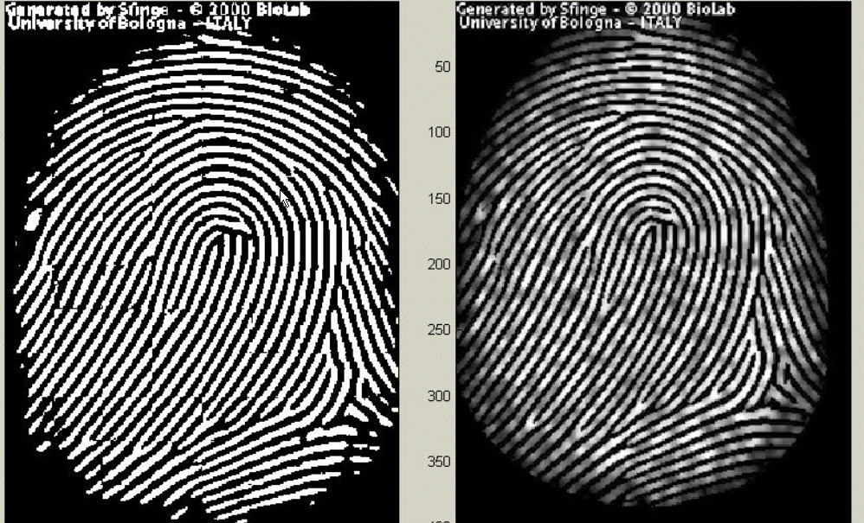
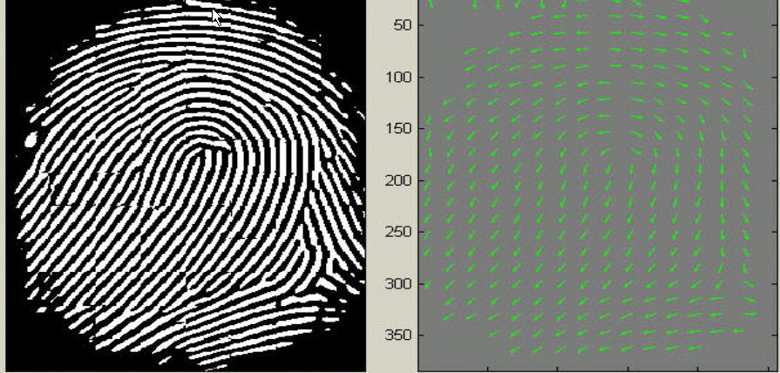
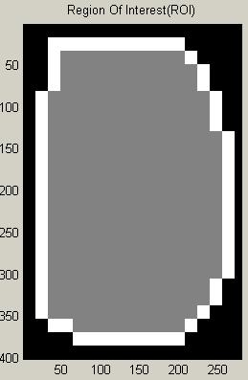
Step 3 – Binarization:
Fingerprint Image Binarization is to transform the 8-bit gray fingerprint image to a 1-bit image with 0-value for ridges and 1-value for furrows.
Fingerprint image after adaptive binarization Binarized image(left), Enhanced Gray image(right)
Step 4 – Image Segmentation:
In general, only a Region of Interest (ROI) is useful to be recognized for each fingerprint image. To extract the ROI, a two-step method is used.
Block direction estimation
Estimate the block direction for each block of the fingerprint image with WxW in size(W is 16 pixels by default).
2. ROI extraction by Morphological operations
Two Morphological operations called ‘OPEN’ and ‘CLOSE’ are adopted. The final image shows the interest fingerprint image area and its bound. The bound is the subtraction of the closed area from the opened area.
Direction map. Binarized fingerprint (left), Direction map (right)
ROI + Bound

Slide 35
Step 5 – Minutiae Extraction:
Part 1: Fingerprint Ridge Thinning
Ridge Thinning is to eliminate the redundant pixels of ridges till the ridges are just one pixel wide.
Part 2: Minutia Marking
After the fingerprint ridge thinning, marking minutia points is relatively easy.
Error handling methods need to be implemented to ensure the triple counting branch error does not evoke.
Step 6 – Minutia Postprocessing
Part 1: False Minutia Removal
The pre-processing stage does not totally heal the fingerprint image.
These false minutiae will significantly affect the accuracy of matching if they are simply regarded as genuine minutia. So, some mechanisms of removing false minutia are essential to keep the fingerprint verification system effective.
Minutia Marking
Part 2: Unify terminations and bifurcations
Each minutia is completely characterized by the following parameters at last: 1) x-coordinate, 2) y-coordinate, and 3) orientation.
False Minutia Structures

Slide 36

Step 7 – Minutia Matching
Given two set of minutiae of two fingerprint images, the minutia match algorithm determines whether the two minutia sets are from the same finger or not.
An alignment-based match algorithm partially derived from the Lin Hong’s "Automatic Personal Identification Using Fingerprints" is used in this project. It includes two consecutive stages: one is alignment stage and the second is match stage.
Alignment stage. Given two fingerprint images to be matched, choose any one minutia from each image, calculate the similarity of the two ridges associated with the two referenced minutia points. If the similarity is larger than a threshold, transform each set of minutia to a new coordination system whose origin is at the referenced point and whose x-axis is coincident with the direction of the referenced point.
Match stage: After we get two set of transformed minutia points, we use the elastic match algorithm to count the matched minutia pairs by assuming two minutiae having nearly the same position and direction are identical.

Slide 37
Quantitative experimental data for fingerprint matching:
Fingerprint 1 | Fingerprint 2 | % Match
101_1 | 101_1 2%noise | 29.1667
101_1 | 101_1 5%noise | 29.1667
101_1 | 101_1 9%noise | 29.1667
101_1 | 101_2 | 29.1667
101_1 | 101_3 | 25
101_1 2%noise | 101_1 5%noise | 56.5217
101_1 5%noise | 101_1 9%noise | 70.3704
101_3 | 101_3 2% noise | 39.1304
101_3 | 101_3 5%noise | 39.1304
101_3 2% noise | 101_3 5%noise | 63.6364
101_1 2%noise | 101_3 5%noise | 43.4783
101_3 | 101_2 | 26.087
101_1 | 102_1 | 20.456
101_3 | 103_1 | 25

Slide 38
FUTURE SCOPE OF WORK
Design of improved and more suitable voice sampling system as part of biometric authentication.
Design of suitable thumb impression gathering hardware as part of biometric authentication.
Testing the effectiveness of data hiding algorithm for judging data hiding imperceptibility and robustness.
Further modification of Data hiding Algorithm to embed and retrieve images of higher resolution.
Optimising Audio Authentication system to distinguish between Similar and different audio with even higher fidelity, especially under noisy conditions.
Alternatively, upgrade the fingerprint SIFT system to take lower-resolution fingerprint images as input and work with it properly.
Design of a comprehensive Client – server program to embed, retrieve and compare steganographic data in Cover documents.

Slide 39
REFERENCES
“National Scholarship Portal (NSP) Standard Operating Procedures”, Version 1.0, July 2019, NSP Team, NIC DBT Mission, Central Ministries of the Onboarded schemes
Mishra, K. N. (2016) “AAdhar based smartcard system for security management in South Asia”, In the Proceedings of International Conference on Control, Computing, Communication and Materials (ICCCCM), pp. 1–6.
Anitha, V., & Velusamy, R. L. (2012) “Authentication of digital documents using secret key biometric watermarking”, International journal of communication network security, Vol. 1, Issue 4, pp. 5–11.
S. Hubli and A. S. Nayak, “Watermarking technique for tamper detection of cheque image in CTS,” International Journal on Recent & Innovation Trends in Computer & Communications, vol. 5, no. 1, pp. 281-284, January, 2017.
Hasan, H. R. (2018) “Copyright Protection for Digital Certificate using Blind Watermarking Technique”, Kurdistan Journal of Applied Research, Vol. 3, Issue 1, pp. 75–79.
(Full list of references can be found in the Documentation)

Slide 40
THANK YOU

